Slide 1
🌊
Daloy
Stablecoin Flow Intelligence for Philippine Remittance Corridors on Stellar
"Daloy" is Filipino for "flow."
APAC Stellar Hackathon · DeFi & Ecosystem Composability · Manila 🇵🇭
Notes:
Daloy — Filipino for flow. An open, zero-cost intelligence layer that makes stablecoin remittance flows on Stellar visible. Solo build, DeFi & Composability track.

Slide 2
The rails Filipino families depend on are a black box
$35.63B
+1%
0
OFW cash remittances in 2025 (record high, 7.3% of GDP)
new US remittance tax as of 2026, on ~40% of inflows
accessible tools to see Stellar's PH stablecoin corridors
Stablecoins on Stellar are a cheaper rail — but nobody can see the flows: volumes, cross-currency activity, peg health, or anomalies.
Notes:
$35.63B in OFW remittances in 2025, record high. New 1% US tax in 2026 on ~40% of inflows. Stellar offers a cheaper rail but the ecosystem is a black box — no accessible visibility into corridors, peg health, or anomalies.

Slide 3
First thing Stellar told me: $8,800,000,000,000 moved in a day.
That's obviously wrong — and why it's wrong is the whole point.
NAIVE FILTER
ISSUER-PINNED
$8.8 Trillion
~$778 Million
asset_code = 'USDC'
anyone on Stellar can mint a token called "USDC"
code + issuer (Circle's verified GA5ZSE…)
−5% of ops, −99.99% of the fake "volume"
Daloy validates data before it charts it. That instinct is the product.
Notes:
The hook. Naive asset_code filter gave $8.8 trillion because anyone can issue a token named USDC — identity is code PLUS issuer. Pinning Circle's real issuer dropped it to ~$778M/day. Removing 5% of ops but 99.99% of the fake volume. This is the difference between an analytics project and a real one.

Slide 4
An ELT pipeline + on-chain attestations — on free tiers
1
2
3
→
→
INGEST
MODEL
SERVE
Stellar Hubble (public BigQuery)
+ CoinGecko API, hourly
dbt medallion:
bronze → silver → gold
tested, built daily
Looker Studio dashboard
+ Soroban attestation
contract on-chain
Cost engineering, not afterthought
A 30-day scan wanted 71 GB — a per-query circuit breaker caught it before the first build. Daily rebuilds at 30 days = 2.1 TB/month, double the 1 TB free quota. Fix: sized the window to 14 days (~530 GB/month) + partition & column pruning.
Notes:
Ingest → model → serve. Bronze layer is outsourced to SDF's Hubble, zero storage cost. Cost engineering: 71GB query caught by a guardrail; daily 30-day rebuilds would be 2.1TB/month vs 1TB free quota, so I sized the window to 14 days. Runs entirely on free tiers.

Slide 5
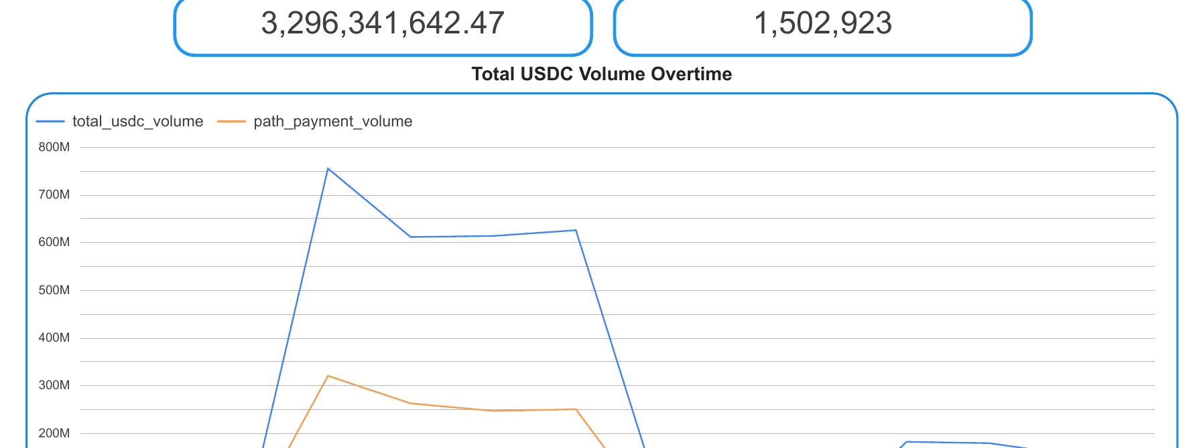
The live dashboard: USDC flow, in real Stellar data
Whale-flow regime
$600–750M
for days on end vs a ~$10–140M baseline — treasury-scale movement, obvious at a glance.
$3.3B total volume · 1.5M payments · updated daily, automatically
Total USDC Volume Over Time — Daloy Dash (live Looker Studio)
Notes:
The live dashboard on real Stellar data. Total volume time series shows the whale-flow regime — $600-750M days against a $10-140M baseline. $3.3B total across 1.5M payments, updated daily automatically.

Slide 6
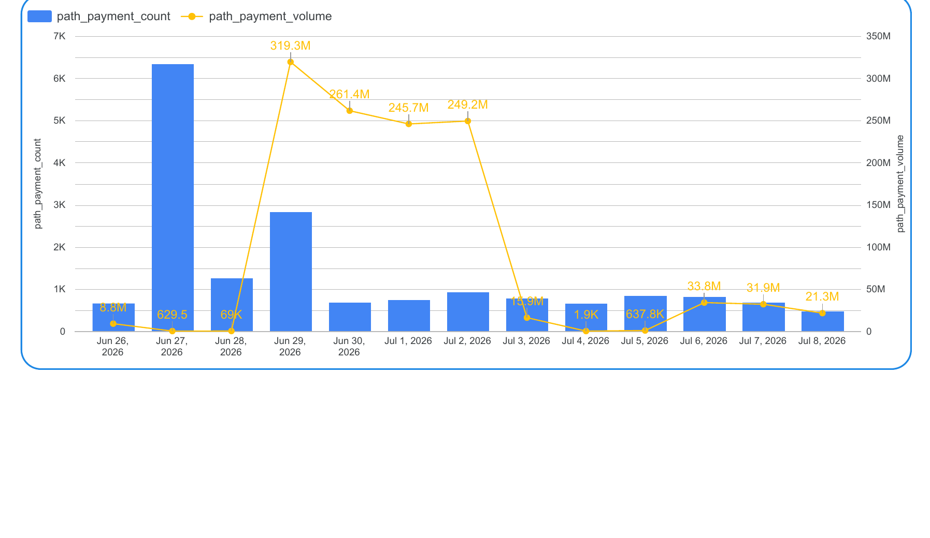
Two anomaly species — and count catches what volume misses
Micro-payment swarm
6,300
path payments in ONE day (Jun 27) moving almost no value — the tall bar with a floor-level line.
Likely bots / stress test. A volume-only view is blind to it.
Cross-Currency (Remittance-Style) Volume — bars = path-payment count, line = volume
Notes:
The combo chart is the money visual. Bars are path-payment COUNT, the line is volume on a second axis. Jun 27: a towering bar of 6,300 payments moving almost nothing — a micro-payment swarm, likely bots. A count-based anomaly view catches this where volume is blind. Different anomaly species, one chart.

Slide 7
Daloy doesn't just show numbers — it publishes them on-chain
A Soroban attestation contract, deployed to Stellar testnet, publishes daily flow-health records anyone can verify.
$ stellar contract invoke ... -- get_attestation --date 20260705
{ "date": 20260705, "usdc_volume": 7129264,
"payment_count": 48542, "is_healthy": true }
Real Jul 5 pipeline data — written to Stellar, read back from Stellar.
Contract: CCQR6OJVMRLKAT7SMBJK2ZGYGWXLJNO2RIYOP3XEKI2EK45Y26TP3T3M
Notes:
The composability payoff. A Soroban contract deployed to testnet stores daily flow-health records on-chain. This is real Jul 5 data written to and read back from Stellar — not a mock. Daloy becomes composable infrastructure: its output is on-chain data other builders can query.

Slide 8
Composable infrastructure, not a closed app
✓
Open dbt models & gold tables
Other Stellar builders query Daloy's corridor intelligence directly — no rebuilding pipelines.
✓
On-chain attestations
Flow-health records live on Stellar; any dApp can read and compose on them.
✓
Path-payment focus
Isolates the true cross-currency remittance mechanism — the rail OFW families use.
✓
Zero-cost & reproducible
Runs on free tiers with scheduled CI; the whole thing is version-controlled and re-runnable.
Notes:
Why this belongs in the DeFi & Composability track. Open models others query, on-chain attestations any dApp can read, path-payment focus on the real remittance mechanism, zero-cost and reproducible. Daloy is a data primitive, not a closed dashboard.

Slide 9
🌊
Built solo. Zero cost. From Manila.
A full ELT pipeline, live dashboard, statistical anomaly detection, and a deployed Soroban contract — and it runs itself.
github.com/OrangeJuice023/daloy
Daloy — making the rails Filipino families depend on visible.
Notes:
Close. Built solo, zero cost, from Manila: pipeline, dashboard, anomaly detection, and a deployed smart contract, all running on schedule by itself. Daloy makes the rails Filipino families depend on visible.

